Slide 1



2G(GSM)

Slide 2
GSM
Abbreviation for Global System for Mobile Communications
Concurrent development in USA and Europe in the 1980’s
The European system was called GSM and deployed in the early 1990’s

Slide 3
Goals of GSM
Good subjective speech quality Low terminal and service cost Support for international roaming
Ability to support handheld terminals
Support for range of new services and facilities
Spectral efficiency ISDN compatibility
■
■
■
■
■
■
■

Slide 4
GSM characteristics
■
previous standard in cellular communication were restrictive
GSM – global digital standard for cellular phones that offered roaming facility
first named Groupe Special Mobile and used in Europe; then usage extended to other continents
GSM operate in frequency bands: 900MHz, 1800 MHz, 1900 MHz
GSM provides voice and data services
■
■
■
■

Slide 5
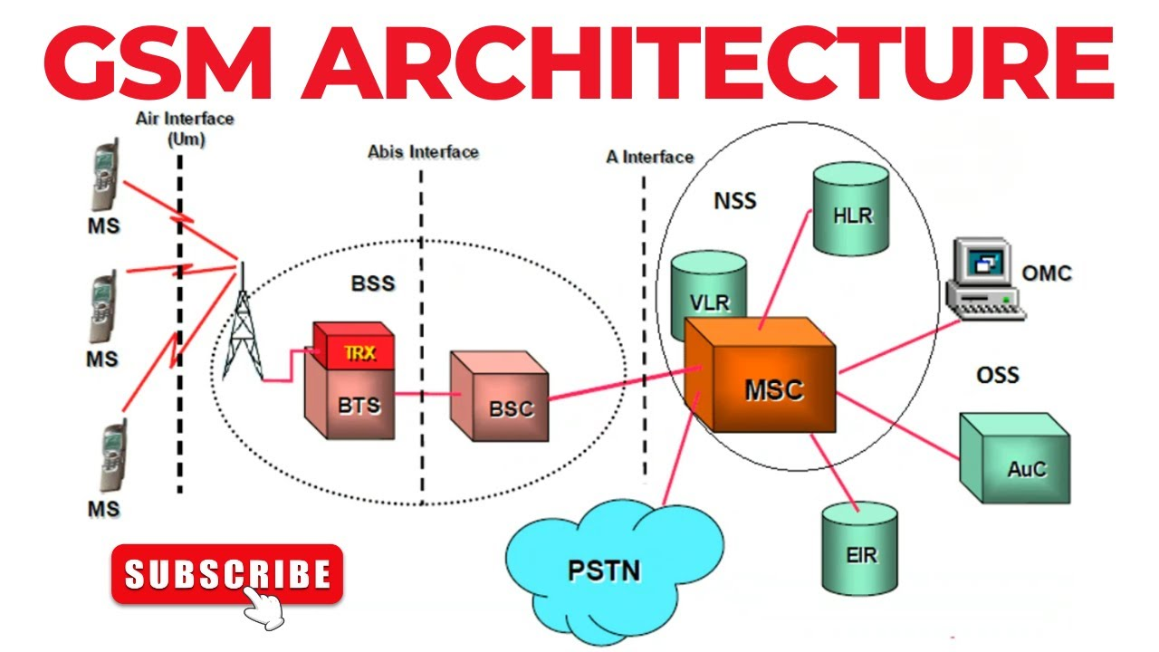

Slide 6
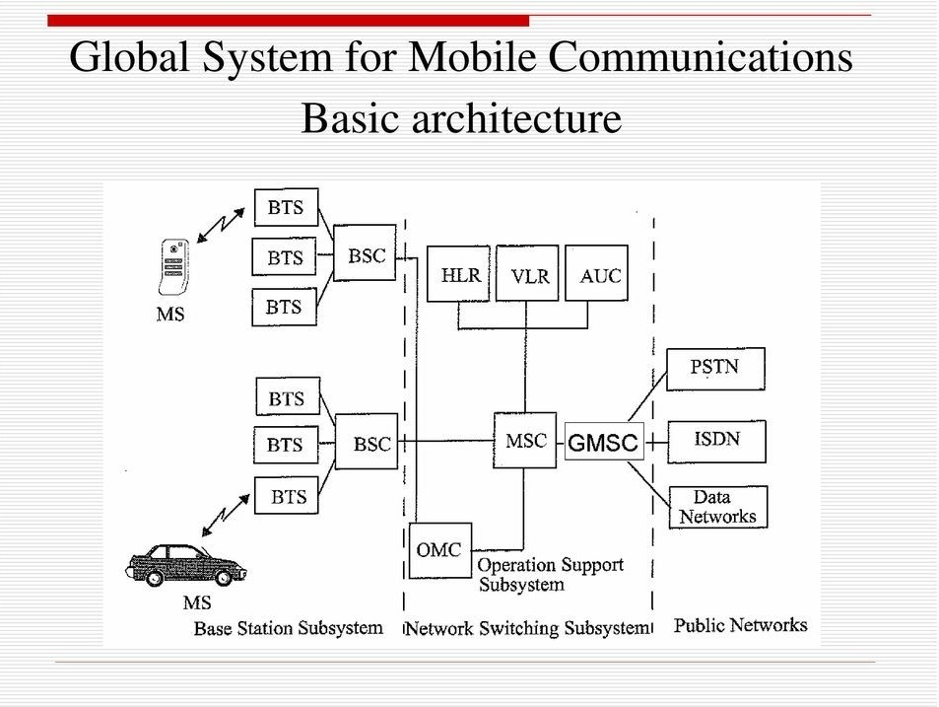
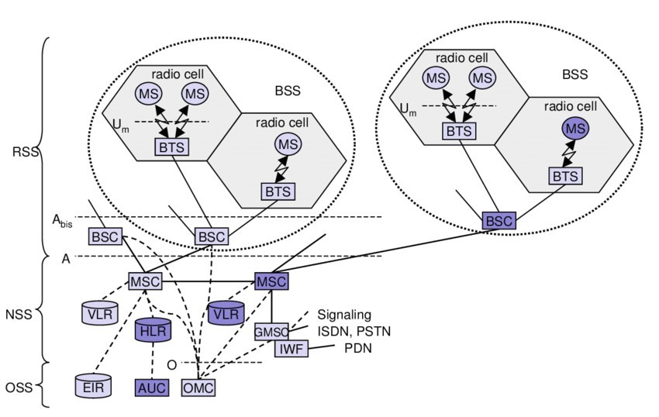
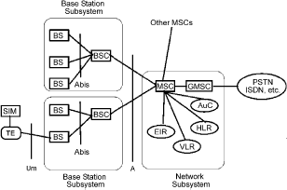
GSM Architecture

Slide 7






Components of a cellular phone (MSU – Mobile Subscriber Unit)
■
radio transceiver – low power radio transmitter and receiver
antenna, usually located inside the phone
■
■
control circuitry – formats the data sent to and from the BTS; controls signal transmission and reception
man-machine interface – consists from a keypad and a display; is managed by the control circuitry
Subscriber Identity Module (SIM) – integrated circuit card that stores the identity information of subscriber
battery, usually the power unit of the phone
■
■
■

Slide 8
Subscriber Identity Module (SIM) card
■
SIM – a memory card (integrated circuit) holding identity information, phone book etc.
GSM system support SIM cards
other systems, like CDMA do not support SIM cards, but have something similar called Re- Usable Identification Module (RUIM)
■
■

Slide 9
International Mobile Equipment Identity (IMEI) key
■
IMEI – a unique 15 digit number identifying each phone, is incorporated in the cellular phone by the manufacturer
IMEI ex.: 994456245689001
when a phone tries to access a network, the service provider verifies its IMEI with a database of stolen phone numbers; if it is found in the database, the service provider denies the connection
the IMEI is located on a white sticker/label under the battery, but it can also be displayed by typing *#06# on the phone
■
■
■

Slide 10
IMEI
■
A 3-digit Type Approval Code (TAC). This is given to the unit after it passes conformance tests.
A 1 or 2-digit Final Assembly Code (FAC). This identifies the place of final manufacture or assembly of the MS unit.
The MS unit serial number.
1 spare digit reserved for future assignment
■
■
■

Slide 11
International Mobile Subscriber Identity (IMSI) key
IMSI – a 15-digit unique number provided by the service provider and incorporated in the SIM card which identifies the subscriber
IMSI enables a service provider to link a phone number with a subscriber
■
■

Slide 12
IMSI
■
A 3-digit Mobile Country Code (MCC). This identifies the country where the GSM system operates.
A 2-digit Mobile Network Code (MNC). This uniquely identifies each cellular provider.
The Mobile Subscriber Identification Code (MSIC). This uniquely identifies each customer of the provider.
■
■

Slide 13
IMEI and IMSI structure

Slide 14
Temporary Mobile Subscriber Identity (TMSI) key
■
TMSI – is a temporary number, shorter than the IMSI, assigned by the service provider to the phone on a temporary basis
TMSI key identifies the phone and its owner in the cell it is located; when the phone moves to a different cell it gets a new TMSI key
as TMSI keys are shorter than IMSI keys they are more efficient to send
TMSI key are used for securing GSM networks
■
■
■

Slide 15
Cellular network components
■
BTS (Base Transceiver Station) – main component of a cell and it connects the subscribers to the cellular network; for transmission/reception of information it uses several antennas spread across the cell
BSC (Basic Station Controller) – it is an interface between BTSs and it is linked to BTSs by cable or microwave links; it routes calls between BTSs; it is also connected to the MSC
MSC (Mobile Switching Center) – the coordinator of a cellular network, it is connected to several BSCs, it routes calls between BSCs; links the cellular network with other networks like PSTN through fiber optics, microwave or copper cable
■
■

Slide 16
Base Station Subsystem
•
Transcoding Rate and Adaptation Unit (TRAU)
–
Performs coding between the 64kbps PCM coding used in the backbone network and the 13 kbps coding used for the Mobile Station (MS)
•
Base Station Controller (BSC)
–
Controls the channel (time slot) allocation implemented by the BTSes
Manages the handovers within BSS area
Knows which mobile stations are within the cell and informs the MSC/VLR about this
–
–
•
Base Transceiver System (BTS)
–
Controls several transmitters
Each transmitter has 8 time slots, some used for signaling, on a specific frequency
–

Slide 17
Network and Switching Subsystem
■
The backbone of a GSM network is a telephone network with additional cellular network capabilities
Mobile Switching Center (MSC)
Visitor Location Register (VLR)
Gateway Mobile Switching Center (GMSC)
Links the system to PSTN and other operators
Home Location Register (HLR)
Equipment Identity Register (EIR)

Slide 18
HLR and VLR
■
Home Location Register (HLR) -
– is a database maintained by the service provider containing permanent data about each subscriber (i.e. location, activity status, account status, call forwarding preference, caller identification preference,Contain subscriber information, authentication information in Authentication Center (AuC))
■
Visitor Location Register (VLR) –
–
–
Contains the location of the active Mobile Stations
database that stores temporary data about a subscriber; it is kept in the MSC of the of the area the subscriber is located in; when the subscriber moves to a new area the new MSC requests this VLR from the HLR of the old MSC

Slide 19
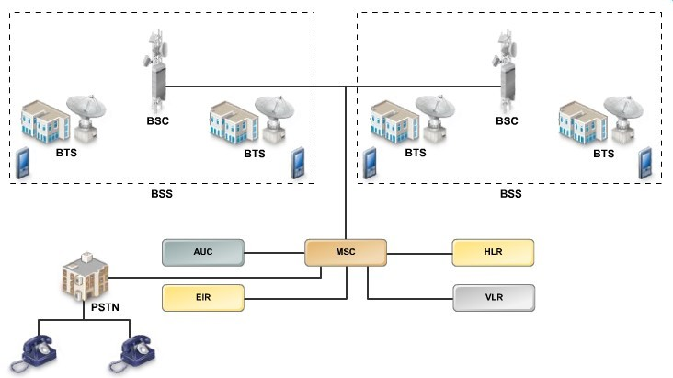
GSM Mobile Switching Center (MSC)
■
is a switching center of the GSM network;
coordinates BSCs linked to it
GMSC

Slide 20
Mobile Switching Center
■
The MSC (mobile switching center) plays a central role in GSM
■
switching functions
additional functions for mobility support management of network resources
interworking functions via Gateway MSC (GMSC) integration of several databases
specific functions for paging and call forwarding termination of SS7 (signaling system no. 7) mobility specific signaling
location registration and forwarding of location information provision of new services (fax, data calls)
support of short message service (SMS)
generation and forwarding of accounting and billing information
■
■
■
■
■
■
■
■
■
■
■

Slide 21
Operation subsystem
■
The OSS (Operation Subsystem) enables centralized operation, management, and maintenance of all GSM subsystems Components
■
■
Authentication Center (AUC)
■
generates user specific authentication parameters on request of a VLR
authentication parameters used for authentication of mobile terminals and encryption of user data on the air interface within the GSM system
■
■
Equipment Identity Register (EIR)
■
registers GSM mobile stations and user rights
stolen or malfunctioning mobile stations can be locked and sometimes even localized
■
■
Operation and Maintenance Center (OMC)
■
different control capabilities for the radio subsystem and the network subsystem

Slide 22
GSM Services
■
Voice, 3.1 kHz
Short Message Service (SMS)
■
■
1985 GSM standard that allows messages of at most 160 chars. (incl. spaces) to be sent between handsets and other stations
Over 2.4 billion people use it; multi-billion $ industry
■
■
General Packet Radio Service (GPRS)
■
GSM upgrade that provides IP-based packet data transmission up to 114 kbps
Users can “simultaneously” make calls and send data
GPRS provides “always on” Internet access and the Multimedia Messaging Service (MMS) whereby users can send rich text, audio, video messages to each other
Performance degrades as number of users increase
GPRS is an example of 2.5G telephony – 2G service similar to 3G
■
■
■
■

Slide 23
GSM Radio Subsystem and Frame Structure
■
GSM uses FDMA and TDMA to transmit voice and data
the uplink channel between the cell phone and the BTS uses FDMA and a specific frequency band
the downlink channel between the BTS and the cell phone uses a different frequency band and the TDMA technique
there is sufficient frequency separation between the uplink freq. band and the downlink freq. band to avoid interference
each uplink and downlink frequency bands is further split up as Control Channel (used to set up and manage calls) and Traffic Channel (used to carry voice)
■
■
■
■

Slide 24



FDD/FDMA - general
scheme, example GSM
f
960 MHz
124
935.2 MHz
1
200 kHz
20 MHz
915 MHz
124
890.2 MHz
1
t
24

Slide 25
GSM uplink/downlink frequency bands
■
uplink and downlink take place in different time slots using TDMA
uplink and downlink channels have a bandwidth of 25 MHz
these channels are further split up in a 124 carrier frequencies (1 control channels and the rest as traffic channels); each carrier frequency is spaced 200 KHz apart to avoid interference
these carrier frequencies are further devided by time using TDMA and each time slot lasts for
0.577 ms.
■
■
■

Slide 26
GSM - TDMA/FDMA
935-960 MHz
124 channels (200 kHz) downlink
890-915 MHz
124 channels (200 kHz) uplink
time
GSM TDMA frame
frequency
 |  | higher GSM frame structures
 | 1 | 2 | 3 | 4 | 5 | 6 | 7 | 8
4.615 ms
GSM time-slot (normal burst)
 | guard space | tail | user data | S | Training | S | user data | tail | guard space
3 bits
57 bits
1
26 bits 1
57 bits
3
546.5 µs
577 µs

Slide 27
GSM hierarchy of frames
hyperframe
0 | 1 | 2 | ... | 2045 | 2046 | 2047
3 h 28 min 53.76 s
superframe
0 | 1 | 2 | ... | 48 | 49 | 50
0 | 1 | ... | 24 | 25
6.12 s
multiframe
0 | 1 | ... | 24 | 25
120 ms
235.4 ms
0 | 1 | 2 | ... | 48 | 49 | 50
frame
0 | 1 |  | ... | 6 | 7
 | slot
 |  | burst
4.615 ms
577 µs

Slide 28
GSM uplink/downlink frequency bands used
GSM Frequency band | Uplink/BTS Transmit | Downlink/BTS Receive
900 MHz | 935-960 MHz | 890-915 MHz
1800 MHz | 1805-1880 MHz | 1710-1785 MHz
1900 MHz | 1930-1990 MHz | 1850-1910 MHz

Slide 29
Security in GSM
■
Security services
■
access control/authentication
■
user ⬄ SIM (Subscriber Identity Module): secret PIN (personal identification number)
SIM ⬄ network: challenge response method
■
■
confidentiality
■
voice and signaling encrypted on the wireless link (after
successful authentication)
anonymity
“secret”:
A3 and A8 available via the Internet
network providers
can use stronger mechanisms
■
■
temporary identity TMSI
(Temporary Mobile Subscriber Identity)
newly assigned at each new location update encrypted transmission
■
(LUP)
■

Slide 30
Security in GSM
■
3 algorithms specified in GSM
■
A3 for authentication (“secret”, open interface) A5 for encryption (standardized)
A8 for key generation (“secret”, open interface)
■
■

Slide 31
Personal Identification Number (PIN)
■
the PIN is stored on the SIM card of the cell phone
when the cell phone is turned on, the SIM checks the PIN; in case of 3 consecutive faulty PIN inputs a PUK (Personal Unblocking Key) is asked for
in case of 10 faulty PUK inputs, the SIM is locked and the subscriber must ask a new SIM
this security measure is within the cell phone and the service provider is not involved
■
■
■

Slide 32


GSM - authentication
mobile network
SIM
RAND
K_{i} RAND RAND K_{i}
128 bit 128 bit
AC
128 bit
128 bit
A3
ES* | 32 bi
A3
SIM
SR
t
SRES 32 bit
MSC
SRES* =? SRES
SRES
SRES
32 bit
K_{i}: individual subscriber authentication key
SRES: signed response

Slide 33
User Authentication
■
a mechanism for encrypting messages in a GSM network
the network sends random data to the cell phone (RAND)
each cell phone is allocated a secret key (KI)
using RAND and KI and the A3 encryption algorithm the cell phone generates a signed result (SRES) which is then sent to the network
a similar process takes place in the network which generates a signed result specific to the cell phone
the network compares its SRES with the SRES generated by the phone and in case of a match the cell phone is connected to the network
■
■
■
■
■

Slide 34


GSM - key generation and encryption
mobile network (BTS)
MS with SIM
RAND
K_{i} RAND RAND K_{i}
128 bit 128 bit
AC
128 bit
128 bit
SIM
A8
it | data
A8
t | SRdEaSta
cipher key
K_{c}
64 b
K_{c}
64 bi
BSS
encrypted data
MS
A5
A5

Slide 35
TMSI-Key Based Security
■
is most used in a GSM cellular network
a TMSI key provides a temporary identification to a cell phone and is provided by the network upon authentication
a TMSI key keeps changing according to the location of the cell phone this way preventing unauthorized access to a channel and preventing intruder from tracing location
the mapping between IMSI and TMSI keys is handled by the VLR
ISMI are used only when the SIM is used for the first time
■
■
■
■

Slide 36
Roaming
■ When a MS enters another operators network, it can be allowed to use the services of this operator
■
Operator to operator agreements and contracts
Higher billing
■
■ The MS is identified by the information in the SIM card and the identification request is forwarded to the home operator
■
The home HLR is updated to reflect the

